Slide 1
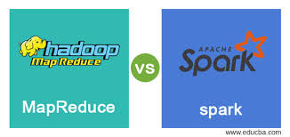
Hadoop MapReduce or Apache Spark?
Presented by Welgama W.I.P.
239185V

Slide 2
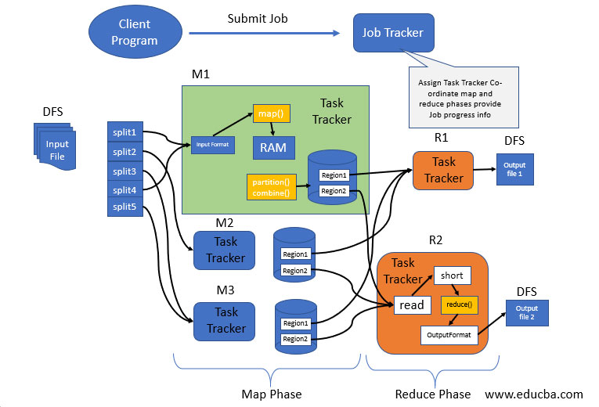
What is MapReduce?

Slide 3
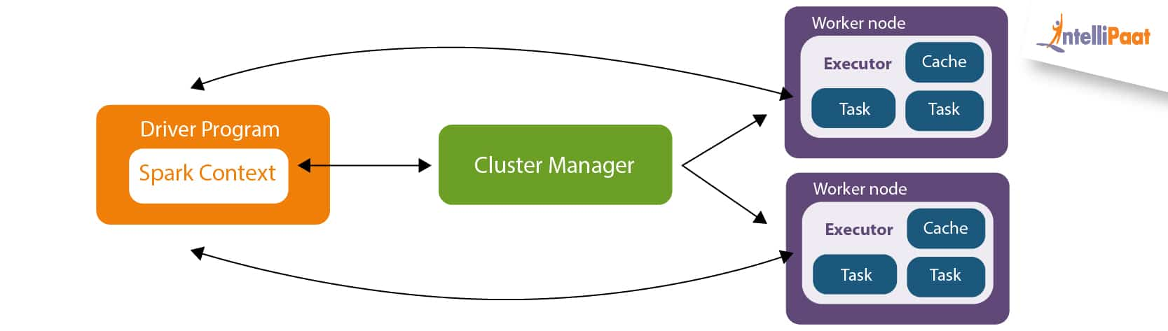
What is Spark?
Apache Spark is an open-source, distributed computing system designed for big data processing. It provides an interface for programming in various languages such as Java, Python, and Scala, and supports various data sources including Hadoop Distributed File System (HDFS) and Cassandra. Spark's main abstraction is the Resilient Distributed Dataset (RDD), which enables fault-tolerant and parallel processing of data across a cluster of computers.

Slide 4

Demo – Part1 MapReduce Framework & HiveQL

Slide 5

Demo – Part2(Using Spark-shell) Apache Spark & Spark-SQL

Slide 6
Demo – Part2(Using Beeline) Apache Spark & Spark-SQL

Slide 7
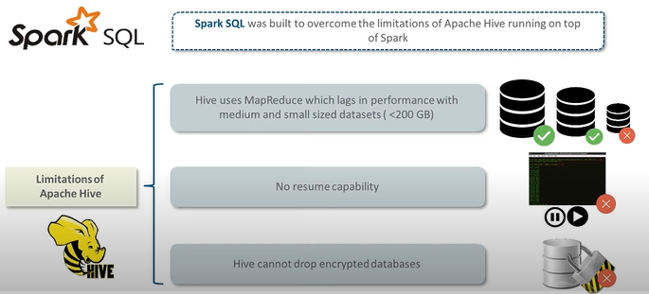
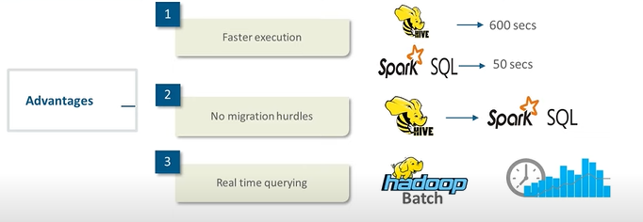
Comparison
Limitations of Hive
Advantages of Apache Spark

Slide 8
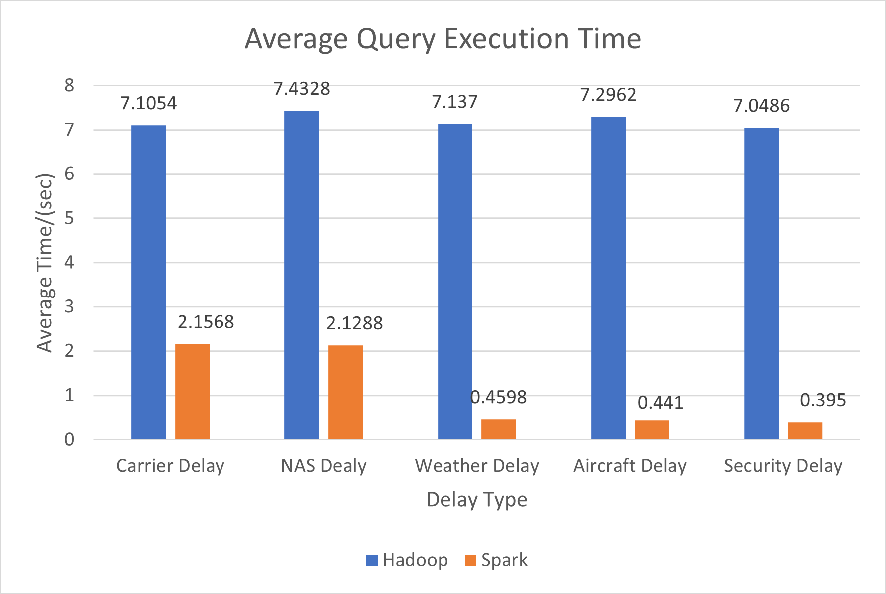
Fast Process? Apache Spark!!

Slide 9
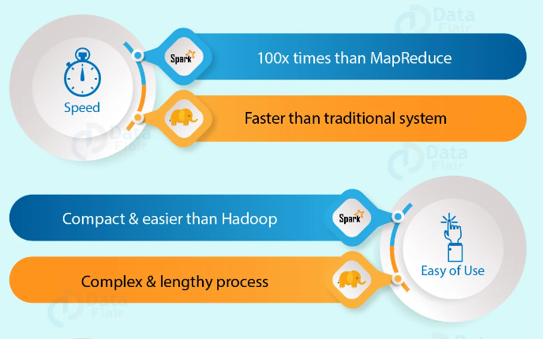
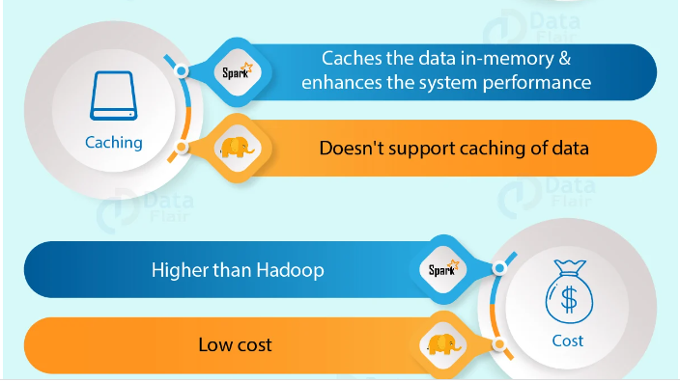
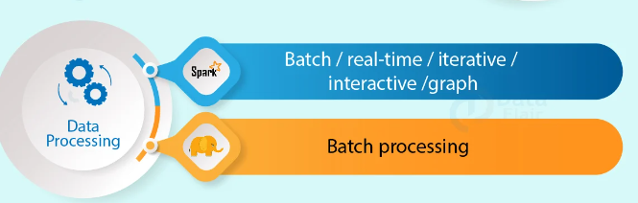
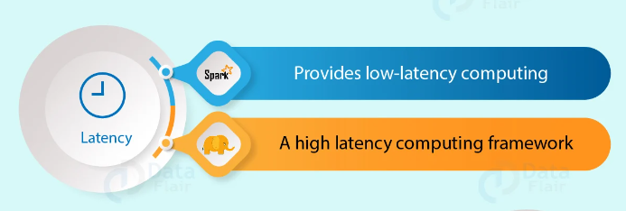
Conclusion

Slide 10
THANK YOU!

